Slide 1
The Classroom Survey – Meet the students from Theoretical Lyceum “Budești” from Moldova
Circle Name: Computer Chronicles Learning Circle 1 (Middle School)
Class Name: 7th “A” form from Theoretical Lyceum “Budești”

Slide 2
Part I. INTRODUCING THE CLASS
A. Teacher's name: Angela Gabureac
B. Grade level: middle (the 7th form)

Slide 3
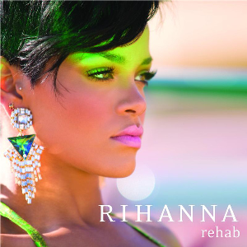
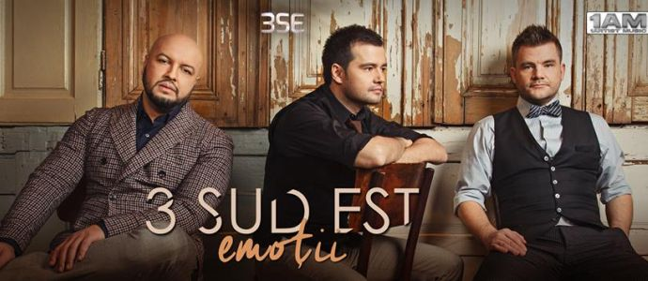
Part I. INTRODUCING THE CLASS
C. Class favorites:
Music groups and singers:
Ed Sheeran,
Rihanna,
3 Sud Est,
Maroon,
Kristina Si;

Slide 4
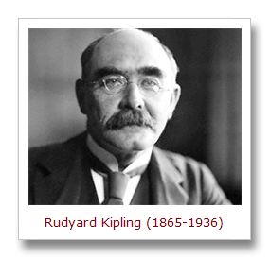
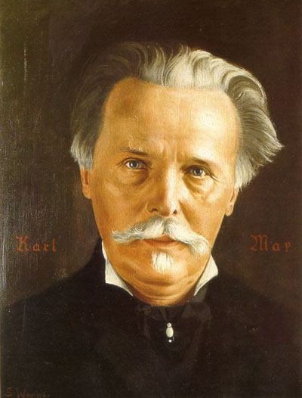
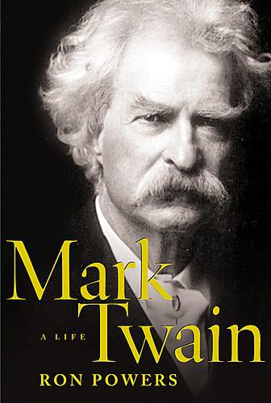
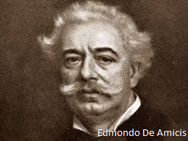
Part I. INTRODUCING THE CLASS
C. Class favorites:
2. Authors:
Rudyard Kipling,
Karl May,
Mark Twain,
Edmondo de Amicis,
Jonathan Swift;

Slide 5
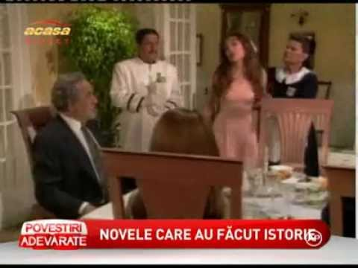
Part I. INTRODUCING THE CLASS
C. Class favorites:
TV programs:
comedy club,
cartoons,
news,
soap operas,
sitcoms

Slide 6
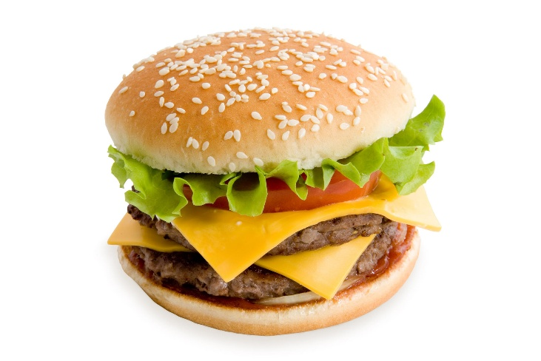
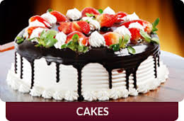
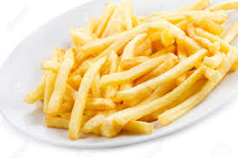
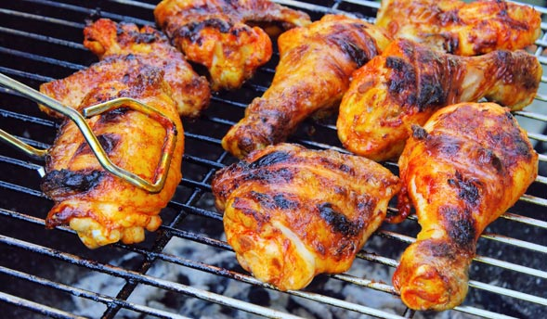
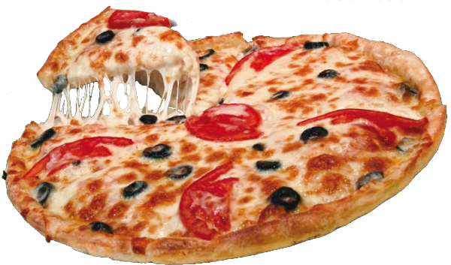
Part I. INTRODUCING THE CLASS
C. Class favorites:
Foods:
hamburgers,
cakes,
fried potatoes,
barbecue,
pizza;

Slide 7
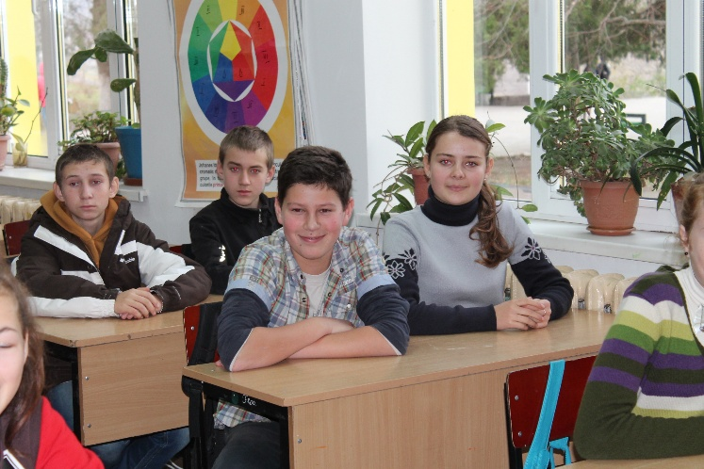
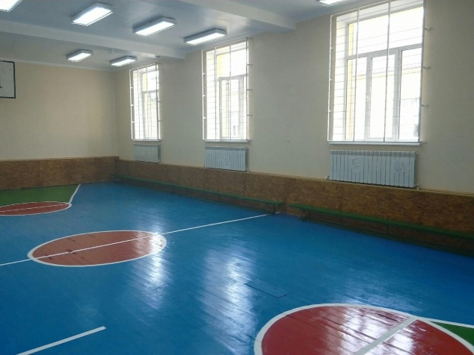
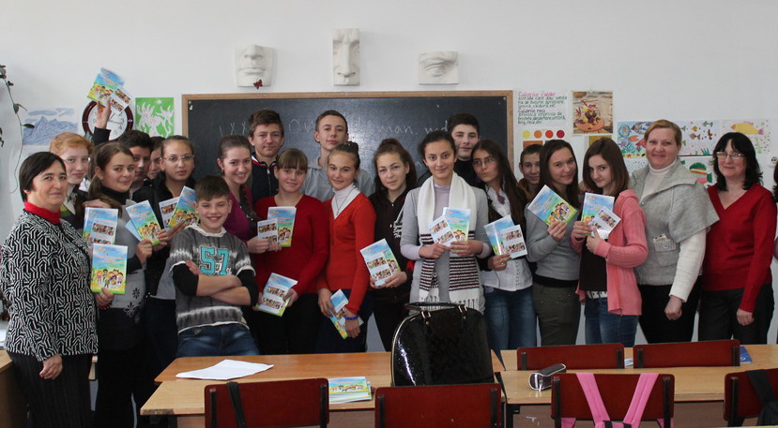
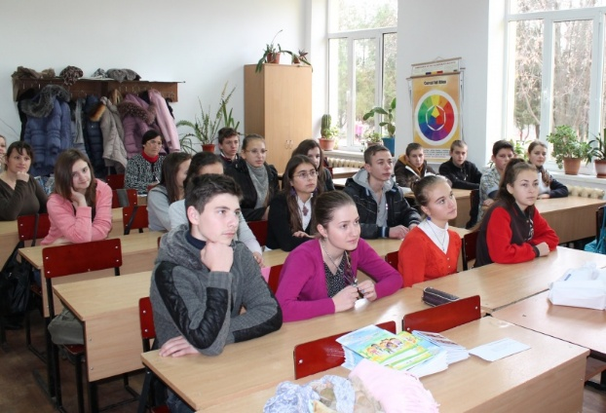
Part I. INTRODUCING THE CLASS
C. Class favorites:
School subjects:
P.E.,
English,
Romanian,
Biology,
Mathematics

Slide 8
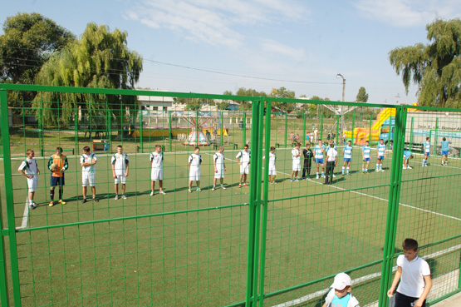
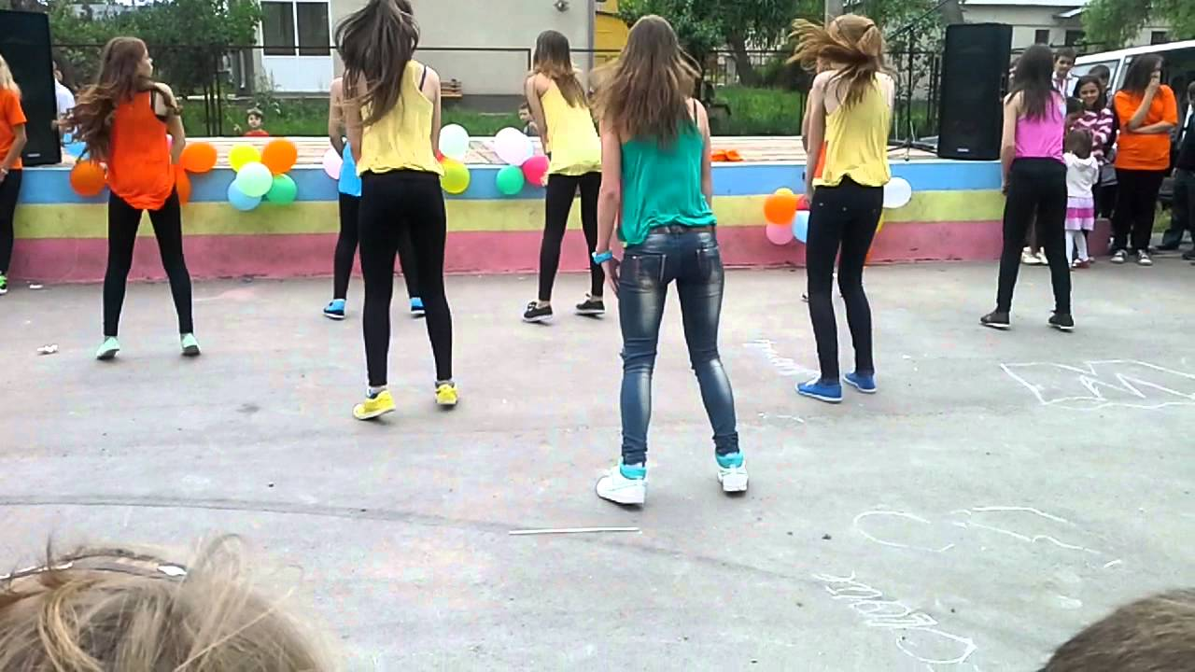
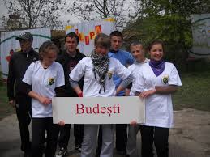
Part I. INTRODUCING THE CLASS
C. Class favorites:
Sports:
football,
volleyball,
basketball,
swimming,
dancing;

Slide 9
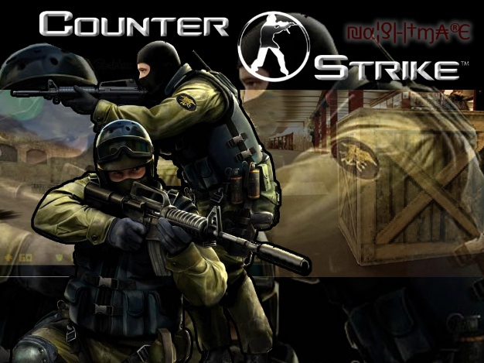
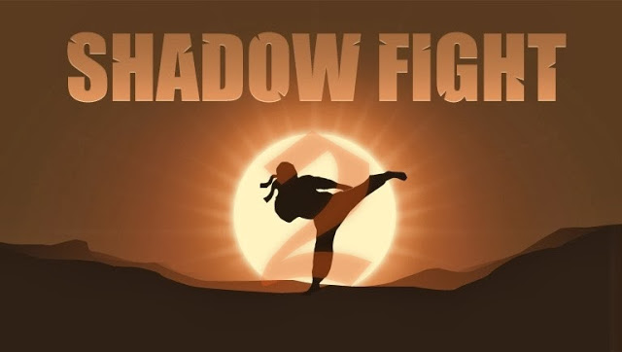
Part I. INTRODUCING THE CLASS
C. Class favorites:
Video games:
Warface,
Need for Speed,
Counter Strike,
Tanki online,
Shadow Fight

Slide 10
Part I. INTRODUCING THE CLASS
C. Class favorites:
Favorite Websites:
ok.ru,
facebook.com,
brainly.ro,
youtube.com,
mail.ru

Slide 11
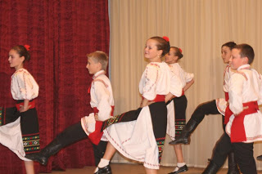
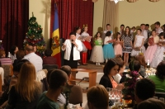
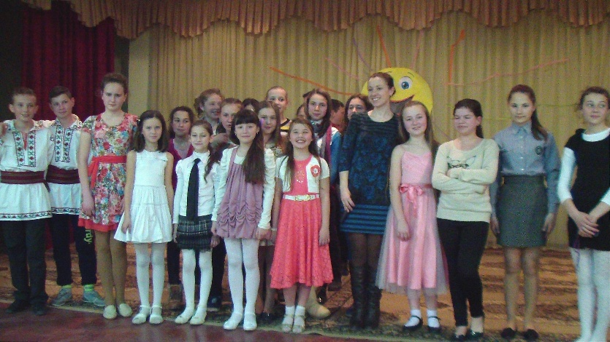
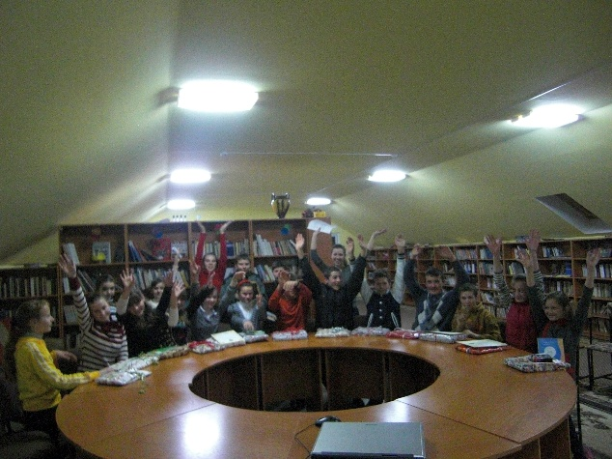
Part I. INTRODUCING THE CLASS
C. Class favorites:
Other Class Favorites:
dancing,
singing,
arts,
drama,
reading

Slide 12
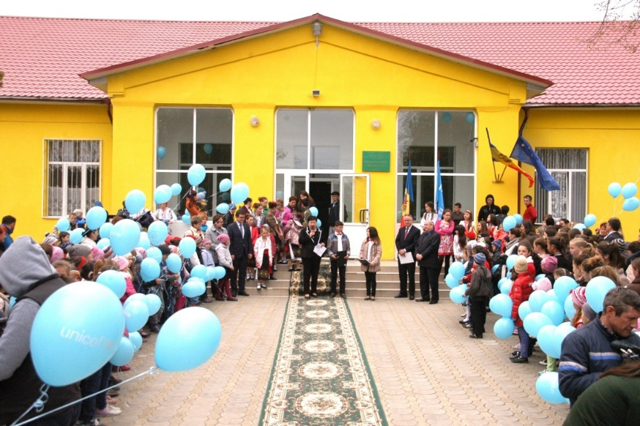
PART II. INTRODUCING THE SCHOOL
A. School information
1. Name and address of class and school:
Theoretical Lyceum Budești,
5, Școlii street, Budești, Chișinău, Moldova
2. Number of students in class and school in class:
in school: 530
in class: 17
3. Size of school:
1760 square meters
4. Type and number of computers:
10 (Pentium 4), 10 (Pentium 3)
5. School history: Theoretical Lyceum Budești activates since 2006, when it was transformed from School No. 61 in lyceum.

Slide 13
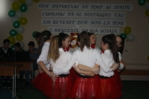
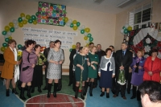
PART II. INTRODUCING THE SCHOOL
B. School program
Our unique school:
"The meeting with graduates" is conducted for already fifty years consecutively, graduates from 5 to 5 years are present. Invitees see their teachers and classmates.

Slide 14
PART II. INTRODUCING THE SCHOOL
B. School program
2. List school calendar from the session dates (holidays and special events that may affect your participation):
The school year begins on the 1st of September. The duration of the school year is 35 weeks for lyceums.
Winter holidays: December 25, 2015 - January 10, 2016
Easter holidays - 30 April to 9 May 2016.
Holidays during the school year are:
from October 29 to November 1, 2015;
from March 4 to March 8, 2016 and
The summer holidays: 31 May – 1 September.

Slide 15
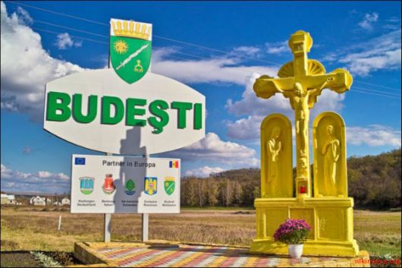
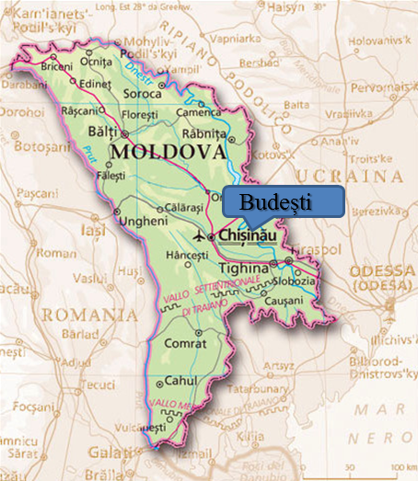
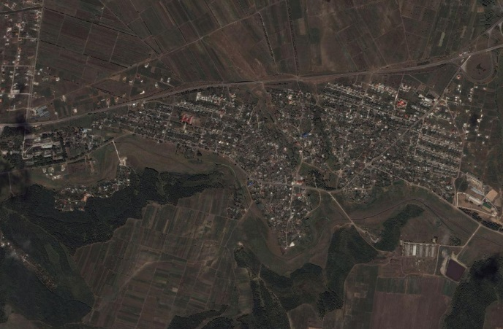
PART III. INTRODUCING THE COMMUNITY
A. Your community
Name of community: Budești (village) fist attested on July 2nd, 1455
2. The emblem of Budeşti
3. Name and size of nearest city: Budești is 12 km far from Chisinău, the capital of Moldova.
4. Location of community
5. The area of your community surface:
2839 ha
6. The population of your community:
5044 in 2010

Slide 16
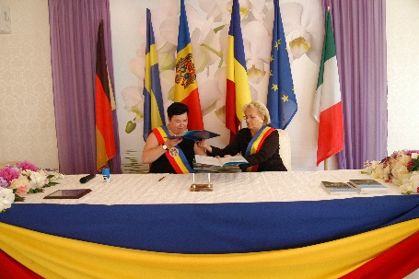
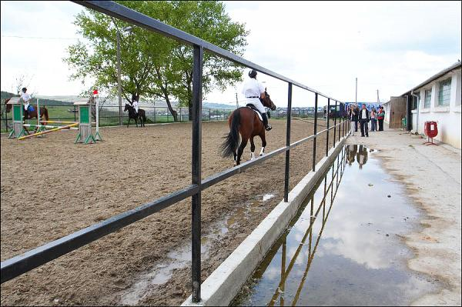
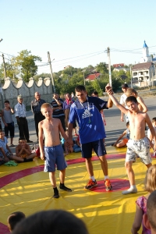
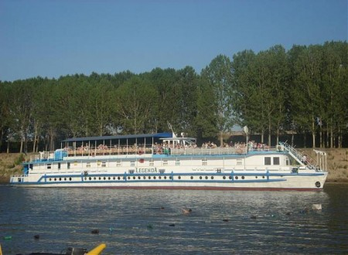
PART III. INTRODUCING THE COMMUNITY
B. Special characteristics
1. List 3 reasons why people come to visit your area:
Twinned communities with Budesti are: Kaufungen (Germany), Bertinoro (Italy), Ale Kommun (Sweden), Cumpăna (România), Comăneşti (România), Băişoara, Cluj, (România).
Horse club "Sparta" (Budeşti) - is the first private European level equestrian complex in Moldova. It is one of the biggest clubs in our country. Here is offered the knowledge of a magical world of working with horses. The club offers services for a comfortable rest and active leisure - riding, taking pictures (photosesions), if you are an experienced rider you will have the opportunity to take a ride on horses and admire the stunning scenery around. Also, under the guidance of a qualified trainer you can try one of the horse racingareas : dressage or obstacle jumping. The smallest animal lovers have the opportunity to go riding on a pony, a donkey or dwarf lambs which are in the clubs mini zoo.
Horse Club Sport includes: renting horses; professional training of the horse; Hippotherapy.
Traditions: September 19th is an important day for us from Budesti. For 20 years in Budeşti isd organized “village day”. On this day we organize the yearly exhibition "Golden Autumn" and in the evening we have a concert where we show local talents. On this day we invite guests (relatives) from other villages in our houses and from other countries in our village.
2. Describe any unusual land formation found in or near your community.
We are 11 km from Vadul lui Vodă where we have lodging sites near the river “Nistru”.

Slide 17
PART III. INTRODUCING THE COMMUNITY
C. Industries:
In Budesti there are 75 economic agents including:
• can production factory -SRL «Fortuna-Plus»
• beer production of "Kelers» -SRL "Makler Plus»
• flowers growing series - SRL "Borodetchi Rurosa»
• Printing - SRL «Paragon»
• Equestrian Sports Club «Sparta»
• Branch Post Office Moldova, Chisinau -Gas, OTC Chisinau
• Individual enterprises rendering services (hairdresser, dentist, tailoring)
• 17 food stores
• 7 coffee bars
• 5 companies with construction materials
• 4 auto services
• 2 stations with fuel foodstuff
• 16 agricultural companies
• 2 sections producing salads
• 1 oil processing sectors

Slide 18
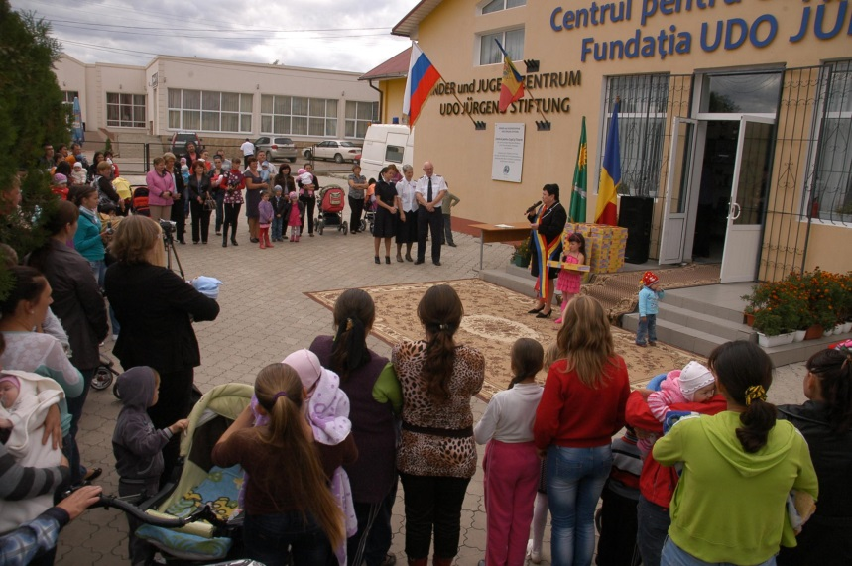
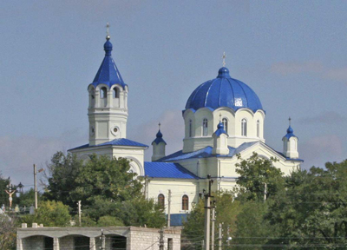
PART III. INTRODUCING THE COMMUNITY
Other info:
Youth Centre
Church

Slide 19
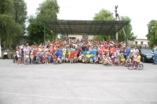
International project "Summer of Friendship”
(3 years) 120 children benefit summer camping " Summer of Friendship”, funded by the Alle Kommun, Sweden. The children are guided by teachers. In the children's interactive activities were included tours in the town of Chisinau and horse club “Sparta”, had at their disposal a playground with all the necessary equipment and an abundant amusement park (carousel, trampoline, slides), the children were fed (dinner and breakfast).

Slide 20
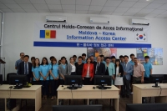
Summer School project in IT
(2 years) , initiated by the Korean Language and Culture Center. 4 Korean volunteers train two types of groups: children and adults.

Slide 21
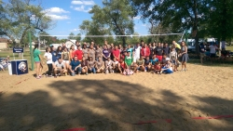
Peace Corps volunteers
The Peace Corps are pleased to work in Budeşti. During guidance training, the volunteers live with Moldavian host families exchanging cultures and learning about customs and traditions.

Slide 22
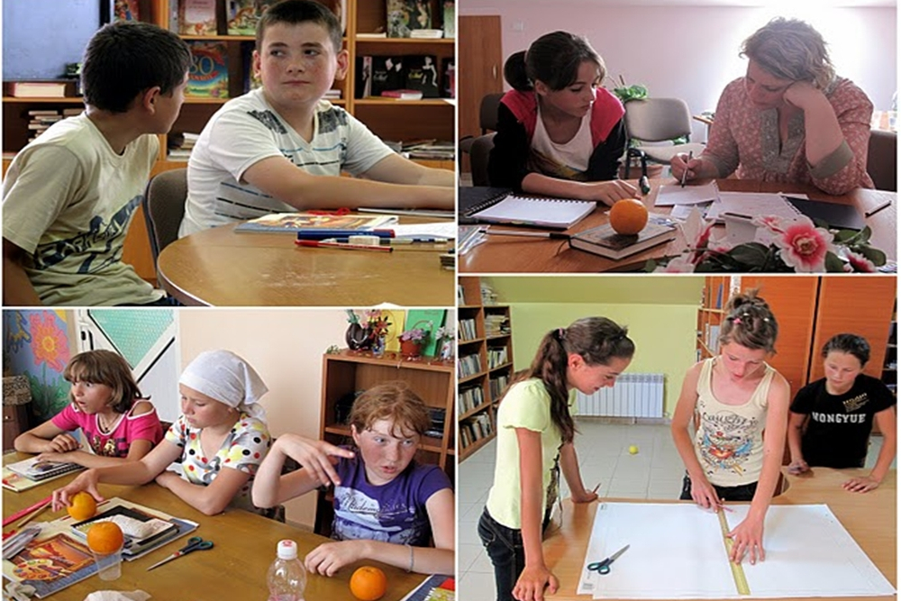
English Summer School at Budești

Slide 23
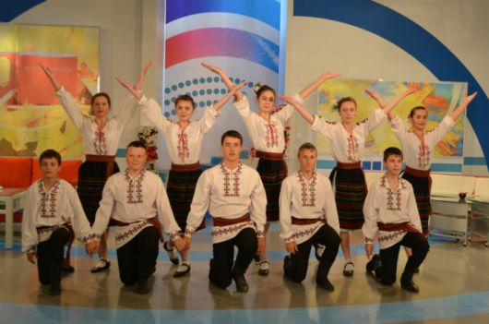
Talented dancer group “Budeștenii”

Slide 24
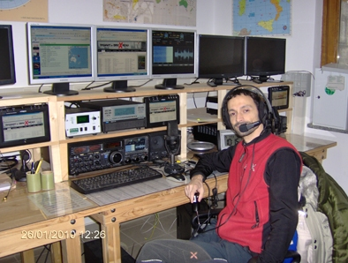
The „Udo Jurgens” youth center radio club
“Radio communication center for amateurs”

